Slide 1
UNLOCK THE EARTH’S SECRETS.
RESEARCH
SURFACE
DATA

Slide 2
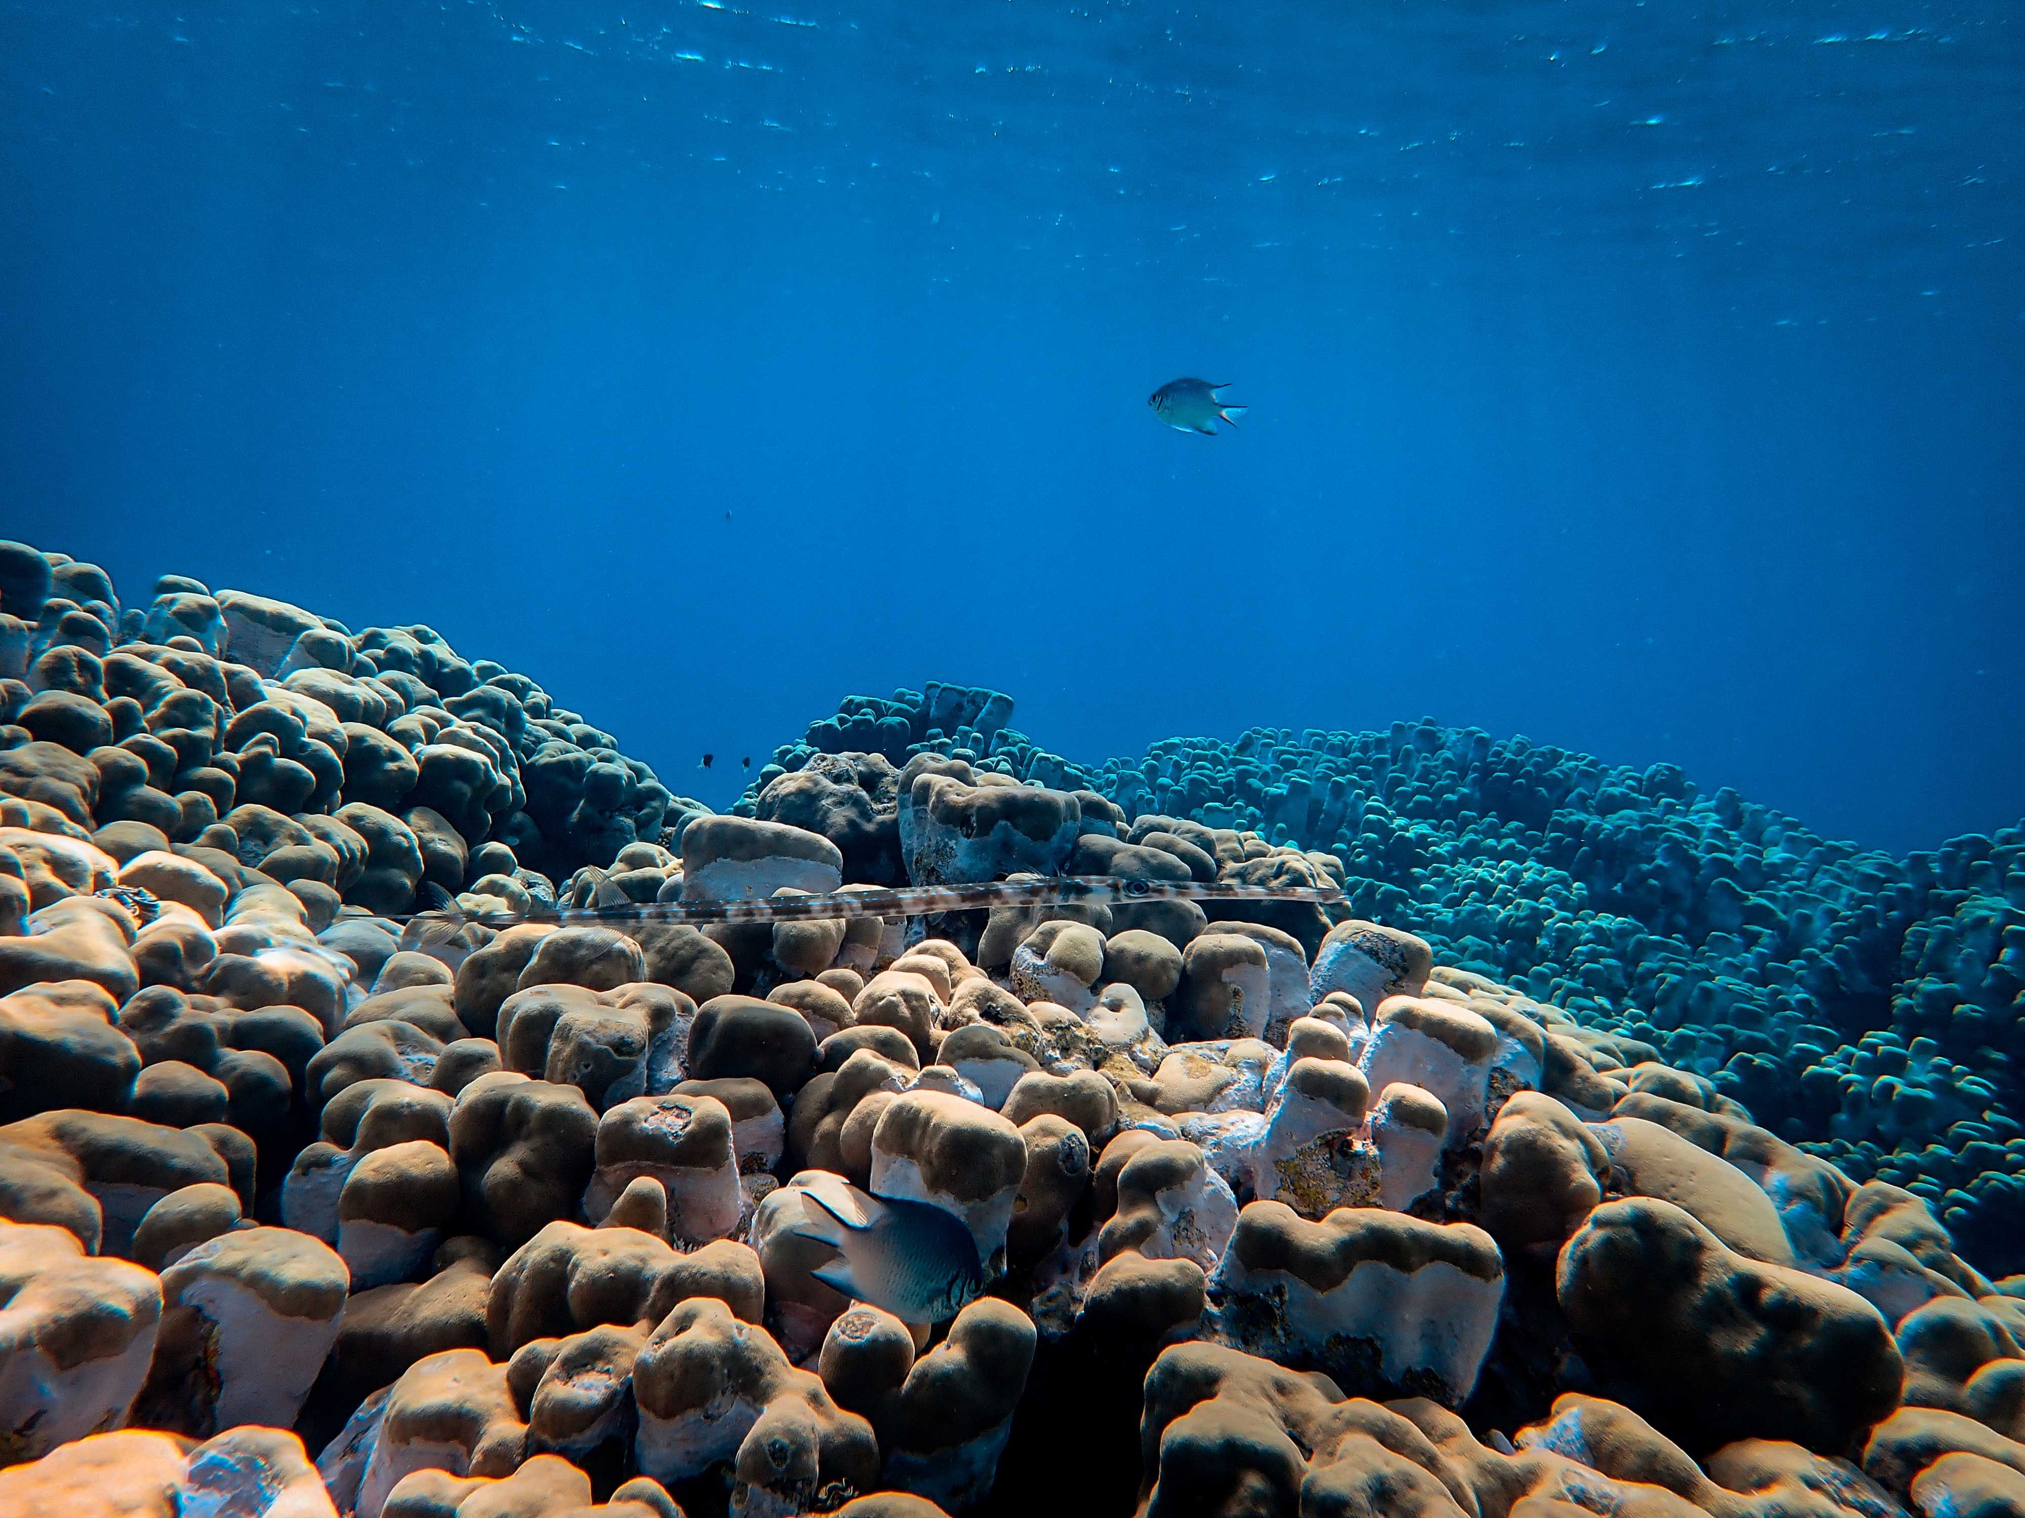
EMPOWERING EARTH EXPLORES:
Democratizing Data for a Sustainable
Tomorrow.
Welcome to GeoquestX, where we believe that the wealth of knowledge about our planet should be accessible to everyone. Our mission is simple but profound: the democratization of Earth data.
I
n a world where information is key, GeoquestX serves as the gateway to a treasure trove of earth science data, fostering a community of Earth Explorers who share, search, and contribute to our understanding of the planet.

Slide 3
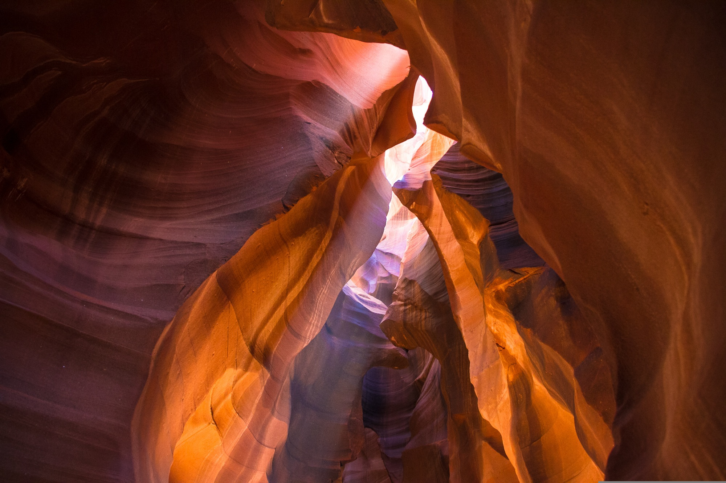
Expolire Earth, Unleash Data:
GeoquestX is more than just a platform; it's a movement to democratize access to earth science data.
Whether you’re a researcher, student, or enthusiast, our user-friendly interface allows you to effortlessly upload, share, and search for a myriad of earth science data.
From geological formations to climate patterns, GeoquestX is your one-stop-shop for exploring the Earth’s wonders.

Slide 4
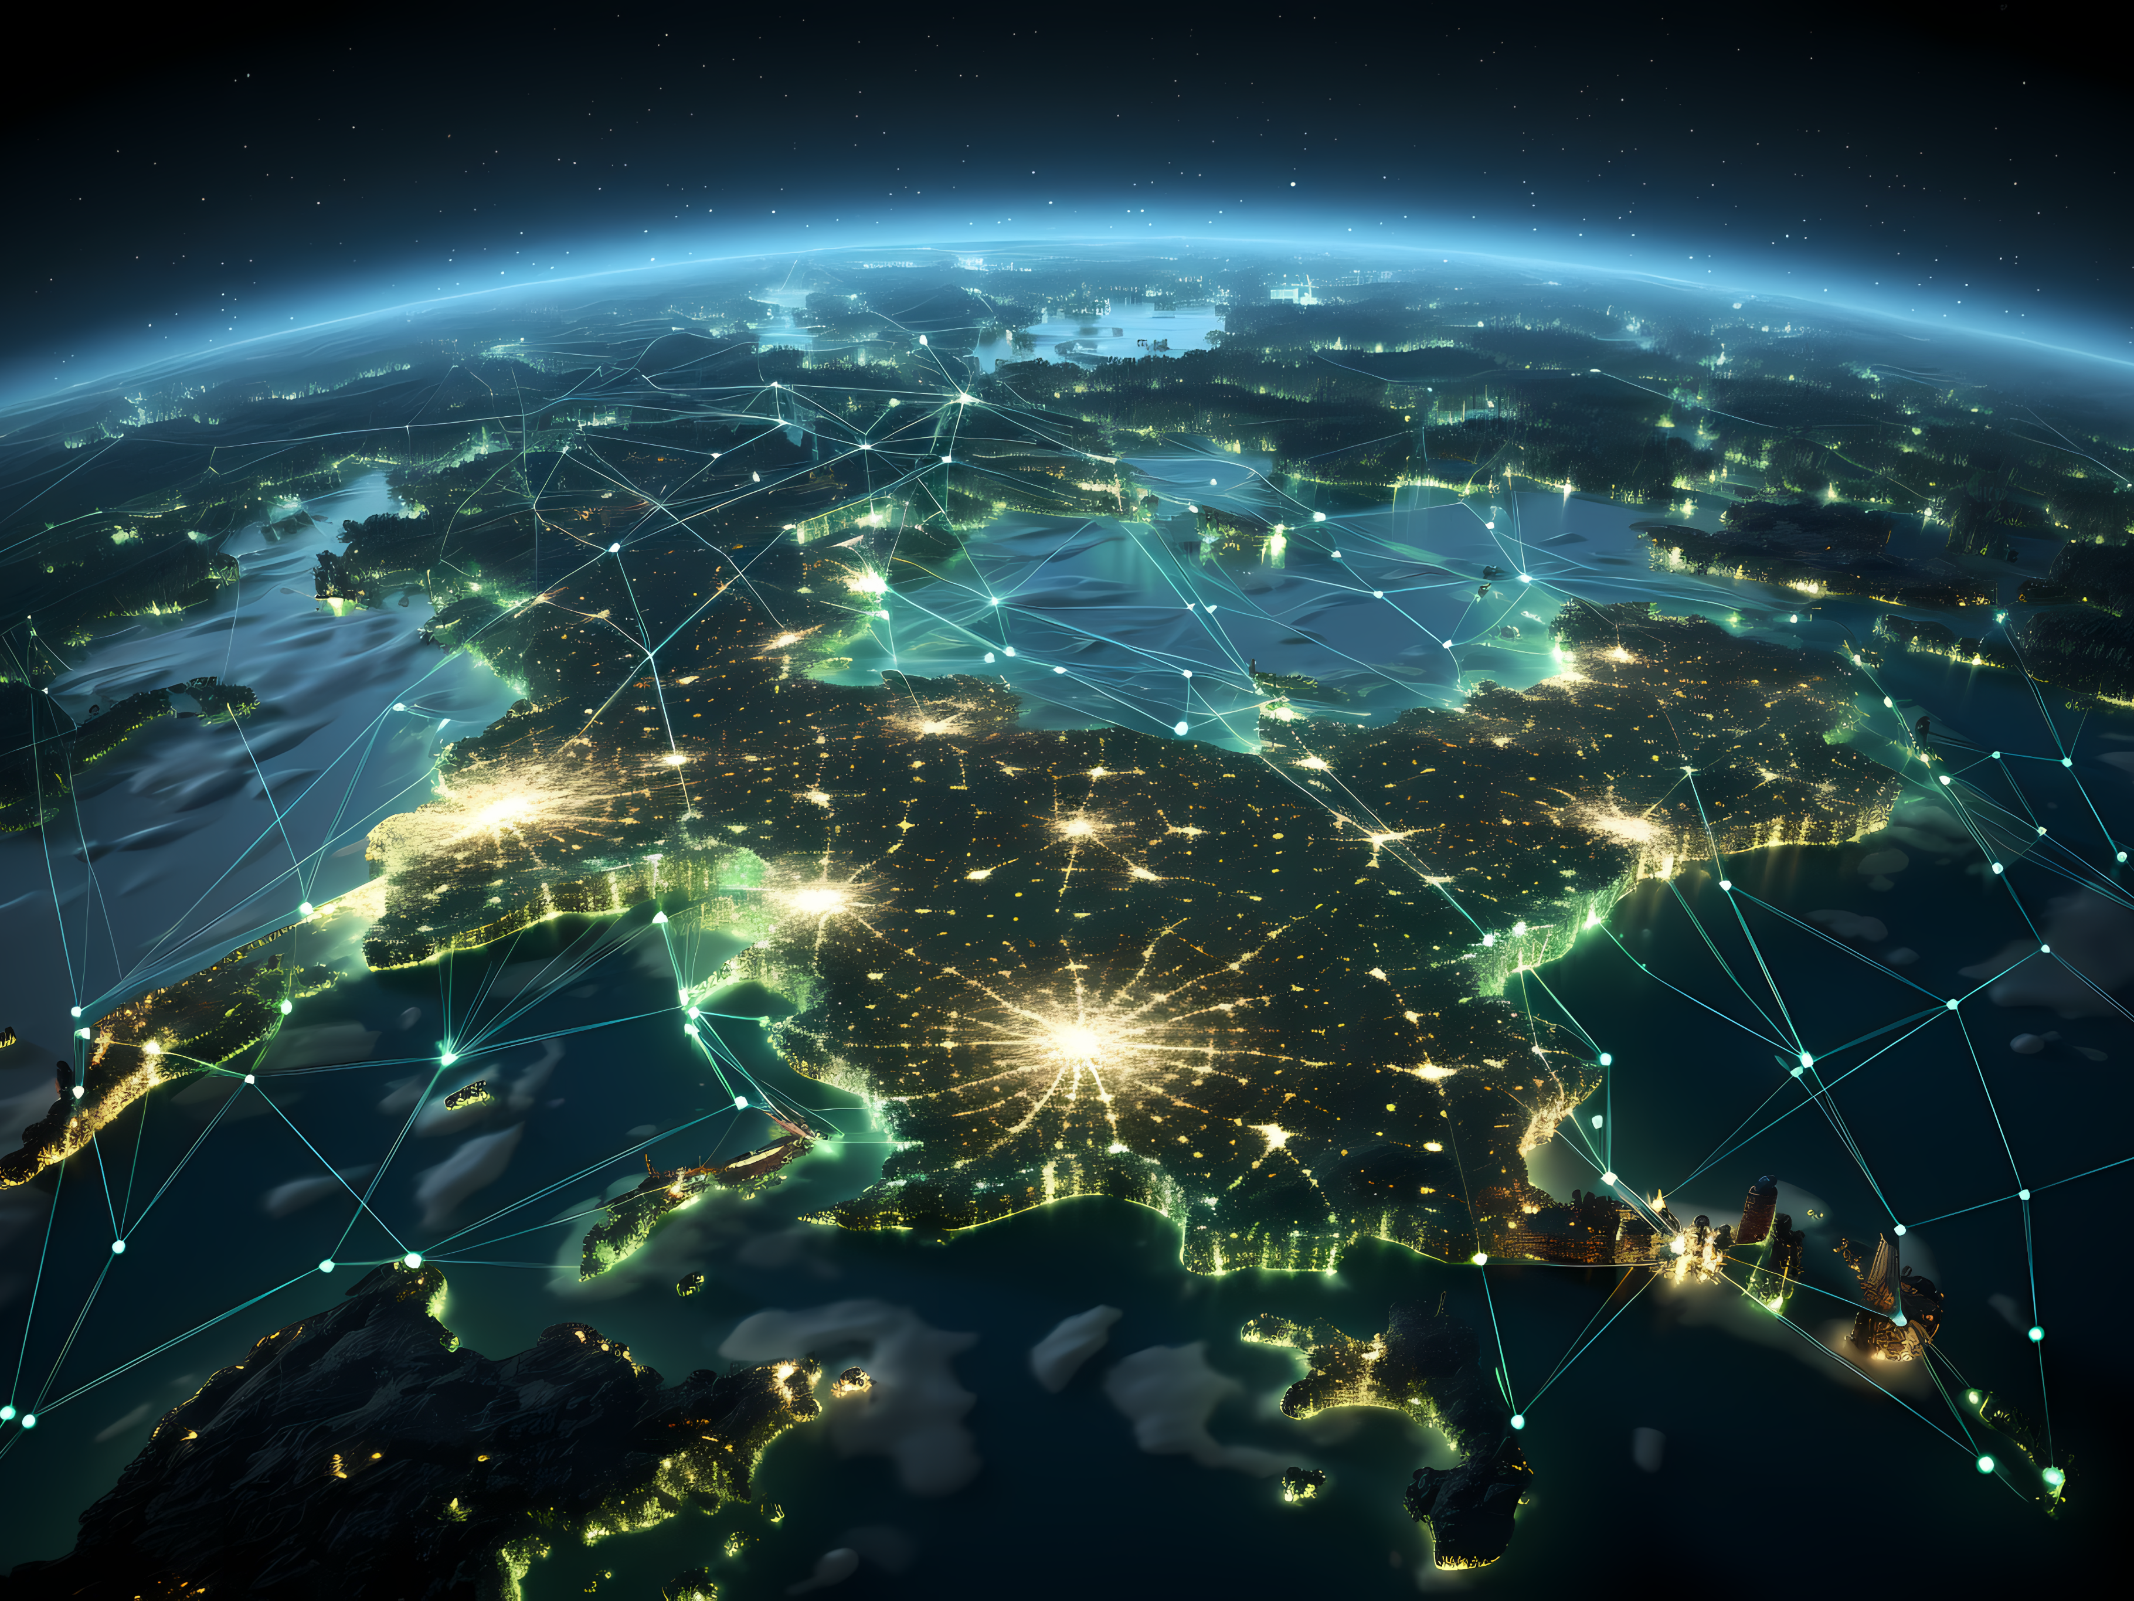
MAP IT, UNDESTAND IT:
Coordinate your data and visualize the Earth like never before. GeoquestX enables users to map their data, providing a spatial context that enhances comprehension.
Whether you’re tracking changes over time or analyzing the intricacies of a specific region, our platform transforms raw
data into meaningful insights.

Slide 5
Real-Time Satellite Insights:
Stay at the forefront of discovery with our real-time data feature.
Access information directly from satellite services to get up-to-the-minute insights into the Earth’s dynamic processes.
Experience the thrill of exploring the planet in real-time, as it unfolds before your eyes.

Slide 6
Innovation Meets Intuition:
GeoquestX stands out as an innovative and intuitive platform designed to deepen your understanding of our planet.
Navigate through data entry, conduct in-depth research, and perform analysis effortlessly.
Our user-centric approach ensures that everyone, regardless of expertise, can actively participate in the exploration and comprehension of Earth.

Slide 7
Democratizing
Earth Data:
At the core of GeoquestX lies a commitment to the democratization of terrestrial data.
Everyone can add data, everyone can search data. We believe that by breaking down barriers and fostering a collaborative global community, we can collectively contribute to a sustainable and informed future.
Embark on a journey of discovery with GeoquestX – where Earth’s data is not confined, but liberated for the benefit of all. Join us in unlocking the mysteries of our planet for a sustainable tomorrow.

Slide 8
BECOME AN EXPLORER
Are you ready to break free from the ordinary and dive into the extraordinary?
GeoquestX invites you to embark on a thrilling journey as a Digital Explorer, where your curiosity meets the vastness of Earth’s untold stories.
It’s time to shatter the limits of conventional exploration and redefine what it means to be an adventurer.
For more info visit:
geoquestx.com
or email at:
info@geoquestx.com
follow us on:
© 2024 GeoQuestX All Rights Reserved. Graphics by rocketsciencecreativestudio.com

